Slide 1


Welcome!
Notes:
الحمد لله It is good to meet all of you.
My name is Omar and I will be your Cybersecurity and Cryptography tutor.
And this is my first time teaching the course at Oxmedica,
So before we begin I just want to let you all know that this lecture will be a bit different.
There is a lot to get through, but rather than me reading directly of my notes,
I would like to get all of you involved.
I will ask each of you to introduce yourself and then read a paragraph.
We will go in order of the room.
So before you begin, if you could please say your name, your age and where you are from.

Slide 2


Oxmedica & Mawhiba
This is the 8th annual collaboration between Mawhiba and Oxmedica, a testament to the exclusivity and prestige of our flagship summer program. Held in the Kingdom of Saudi Arabia since 2016, this year's program boasts a record number of enrolled students, approximately 500 across the male and female programs. As students, we are not just participants but part of an elite group within the top 1% of aspirational and ambitious high school students.
Mawhiba is a programme established by King Saud’s Education is a cornerstone of Prince Salman’s Vision 2030, and this program is a key part of it. A core ambition of Vision 2030 is to build an independent economy away from the petroleum industry. Part of that is to educate children to grow up to have thriving businesses and careers in wider industries – of which education is an integral foundation.

Slide 3
Who are Oxmedica?
As part of Oxmedica, we are committed to making a lasting impact on STEM (scientific, technological, engineering, and mathematical) knowledge. We aim to inspire the next generation and offer them a unique experience that will shape their future. We are a global team of experienced academic, research, and career professionals. This will be a high-intensity, bespoke academic program aimed at aspirational high school students spanning an extremely important core STEM discipline – Cybersecurity and Cryptography. You will not only gain theoretical knowledge but also have a series of immersive, impactful and academically rigorous lectures and workshops specially designed to enhance every student's personal character and subject knowledge, setting you up for a successful future in the field.

Slide 4
Teaching and Residential Assistants
Through Mawhiba, you will have a teaching assistant who will assist throughout this programme. They will assist with lessons, field trips, and equipment planning. You will also have a residential assistant (between each student group of 8-10 students). They are university students who will help manage logistics such as getting to/from classrooms and restaurants, dealing with accommodation matters, checking in, and any enrichment and weekend activities.

Slide 5
Teaching Pedagogies
We expect you as students, individually and collectively, to be well-mannered and well-behaved, trying your best to do the work to the best of your ability. We expect you to listen when tutors and instructors speak and only speak when instructed. There will be no assigned homework – please maintain a good work/life balance, and there is no need to do extra work outside of the classroom.

Slide 6
Teaching Pedagogies
Lectures will not be very long unless necessary. There will be many substantial activities – lab work, demonstrations, group discussions, competitions, creative work, debates, workshops and potentially a guest lecture. You are expected to engage in scheduled debates, complete worksheets, pay attention to and make notes to lectures, present in group and individual presentations, and ask questions in question-and-answer sessions. Lessons will always end with key messages and learning points. Regarding classroom management, please be prompt and punctual.
Breaks will be provided where necessary.

Slide 7
Teaching Pedagogies
If we finish early, then we will move on to the next topic if there is enough time (in which it makes sense to move on). Otherwise, you can focus on programming in Codecademy or ask me questions. The focus is on having a clear trajectory and strong motivation from the outset. The goal is not to impart as much theoretical knowledge as possible but on skills, building in practical and applied elements where possible. We aim to inspire, intrigue, and encourage dialogue in one of the most forefront fields in the tech world.

Slide 8
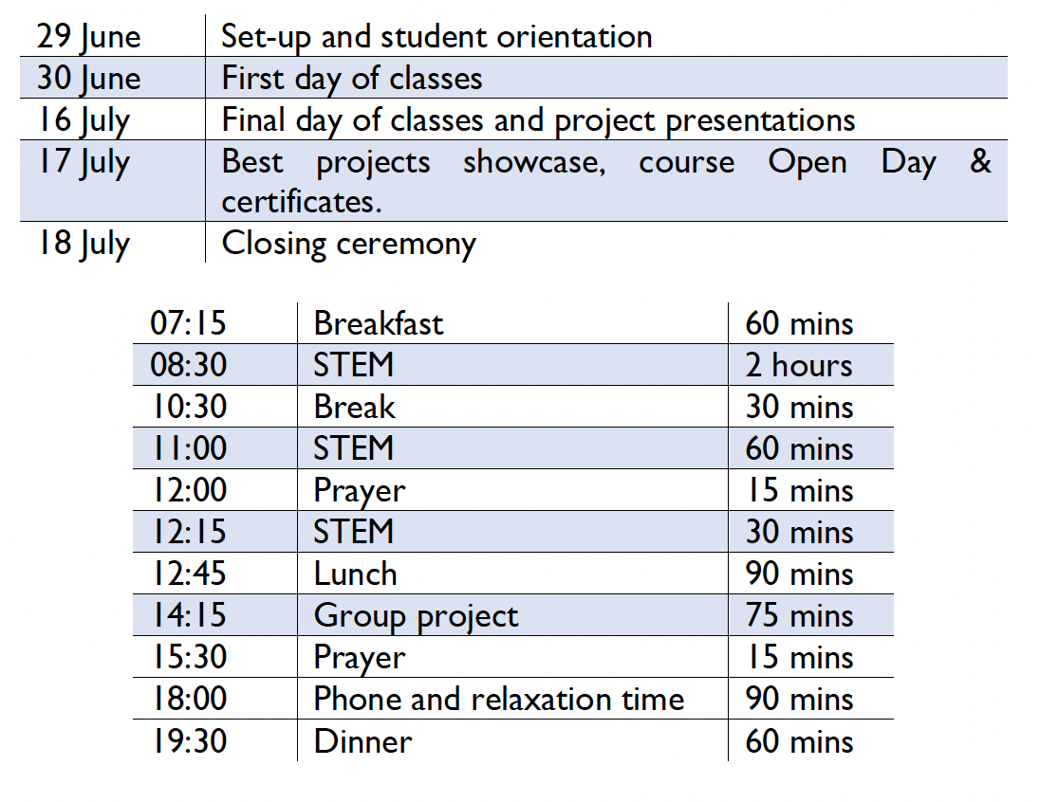
Course Introduction
29th June – 18th July 2024 (3 weeks)
Tutor: Mr Omar Choudhry
Please review the Pre-course Student Handout
Establish Teaching Pedagogies
MBA Bootcamp/Tech Summit
Course: Cybersecurity and Cryptography
Final Group Project Introduction
Assessment
Notes:
Timetable
3.5 hours x 12 days + 2 hours x 1 day = 44 hours
30 core topics, 9 specialist topics, 3.5 field trip, 0.5 course survey, 1 intro

Slide 9
MBA Bootcamp
In addition to academic learning, you will also have an opportunity to attend an MBA Bootcamp and Tech Summit. The MBA Bootcamp focuses on turning scientific discoveries into useful technologies, mastering interconnected fields, and identifying critical problems that need to be solved. It will also focus on utilising key themes from leading MBA programs (e.g., the Harvard MBA case method), varied topics, and quick acquisition and understanding of key business concepts.
The MBA Bootcamp will be on Saturday, July 6, during Week 1

Slide 10
Tech Summit
The Tech Summit addresses the foremost relevant tech themes today: AI, disruptive technologies, ethics and policy-making, impact on sustainability, and maximum exposure to crucial tech issues in diverse fields.
As your tutor, I will deliver a talk at the Tech Summit, “A New Age Of Fabrication”. I will hope to cover 3 main topics: Fake News (how AI algorithms can generate realistic but entirely fabricated news articles and videos, influencing public opinion and potentially swaying elections), Echo Chambers (amplification of misinformation and creating polarised communities) and Deepfakes (from explicit content to professional theft sand falsified religious verdicts).
The Tech Summit is on Saturday, July 13, during Week 2.

Slide 11
Course Topics
Career Paths in Cybersecurity
Critical Cybersecurity Case Studies
Architecture of Computers
Database Systems
Cryptographic Techniques
Network Security Concepts
Cybersecurity Legislation and Regulation
Hacking and Cyber Attacks (Cyber Attacks, Malware and Viruses, Threat-Vectors and Threat Agents)
Specialist Topics (Advanced Coding, Data Science, Artificial Intelligence)

Slide 12
Course Brief
This course will introduce you to fundamental components of computer science with a particular focus on key tenets of cybersecurity and cryptography. Students will begin by understanding the basic language and architecture of computers, networks, and database systems and will investigate the different possible security threats that computer systems confront. You will consider what value your private data might hold for organisations and how organisations might use this data in nefarious ways without seeking your permission. Students will then look at social engineering techniques cybercriminals use to trick users into giving away their personal data. The course then turns its attention to more common cybercrimes such as hacking, DDoS attacks, and malware and considers methods to protect themselves and our networks against these attacks. You will also learn the basics of cryptography and how to encrypt and decrypt using ancient and modern cyphering techniques. Students will undergo regular individual/group-based class exercises to implement their learning in various cyber threat scenarios.

Slide 13
Course Outcomes
After taking this course, students will be able to:
Encrypt and decrypt messages using a variety of cyphering techniques
Describe the basic structure of computer networks and the most common ways in which
these networks may be attacked
Code and debug simple cybersecurity software without assistance
Understand the role of cybersecurity in business and government
This course will approach computer security through a systems thinking lens. Each lesson will build on the previous to construct a complete understanding of how the Internet works and how it can be exploited.

Slide 14
Course Trajectory
Cybersecurity is a discipline within computer science that identifies weaknesses and develops defences for systems, networks, and programs against attacks. The primary objective of cybersecurity specialists is to develop technologies into robust systems that protect the user. This course is designed to provide an introduction to the discipline of cybersecurity complimented with a foundational understanding of computing necessary to comprehend security deeply.
The course is structured to first address the components and architecture of computers such as your laptop or mobile phones. With each topic, the class will utilise an attacker mindset to execute attacks and identify vulnerabilities in technologies in order to create more robust defences.

Slide 15
Specialist Topics
You will have the opportunity to benefit from some of my specialisms in this course in the final week of the programme. As mentioned in my tutor information, my key areas are within artificial intelligence. Machine learning and the whole artificial intelligence field are so important that it is integral to teach students what this is and how it works so that it isn’t just a mystery. The applications are endless, and we will make sure to show how we can apply ML and AI to cybersecurity and cryptography with practical examples. Given that only 9 hours of course time is available to teach these topics, the goal would be to equip students with the most practical knowledge and develop their skills within this limited time. Even though there are many, it is essential to discuss aspects of each so that students are aware of what exists in the real world and what is used in industry.

Slide 16
Specialist Topics
You will work for roughly 75 minutes daily on a final project of about 4 or 5 students. You will be paired up with students from the Mechanical Engineering course. You will be designing a secure, sustainable power grid.
STEM group project: Designing a secure sustainable power grid. This project will involve two core aspects: designing a sustainable power grid using renewable energy sources and a relevant, robust cybersecurity framework. The cybersecurity aspect will consider secure communication channels, encryption of data transmissions, and authentication protocols for grid access and control. The engineering aspect will focus on creating a sustainable energy source that could be developed within Saudi Arabia. It will consider the process of collecting, storing, and converting energy to electricity, but mainly transportation of the energy, thinking about the required physical infrastructure.

Slide 17
Specialist Topics
Certain aspects need to be considered, such as what happens in the case of an actual attack and what fail-safes are in place, energy-specific issues such as solar only working during clear day-time or safety and economic challenges for nuclear power plants, geographical locations, challenges with integration into any existing electrical grid and political challenges.
Also, evaluate if a distributed power grid is better than a single large power plant (a grid generally has more redundancy, but the probability of a successful attack increases due to the increased connections in the notebooks and with a larger number of physical locations). This project will be interesting for the students as it combines both disciplines in an extremely relevant field, constituting various principles and ideas from both courses.

Slide 18
Specialist Topics
The main deliverables and forms of assessment will be a 4-page report (50%, based on application of technical knowledge, relevance to the real-world, novelty and innovation, organisation and clarity), a set of slides (25%, based on clarity, conciseness, use of media and diagrams) and the physical presentation (25%, based on delivery and communication skills, time-management and answering questions).
Remember that the final product must have a strong oral component with visual aids (pitch, proposal, presentation, …) with a maximum time limit of 10 minutes per group. We will have combined in-class group project presentations on 16 July, and then the best groups from all courses (just 1 group for our course) will showcase their projects on 17 July.

Slide 19


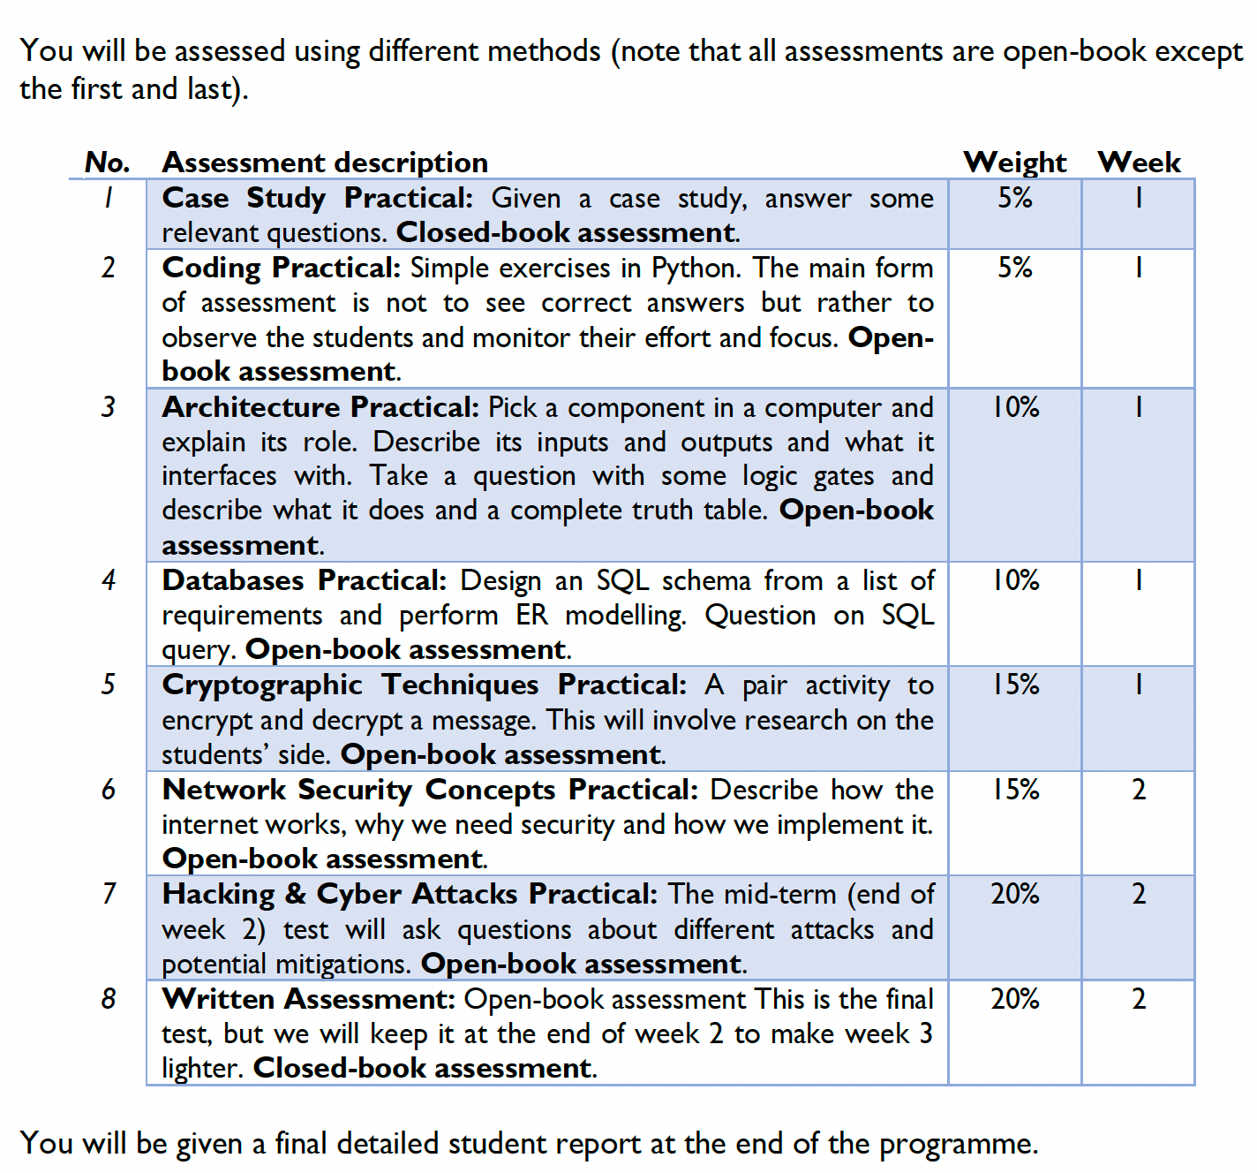
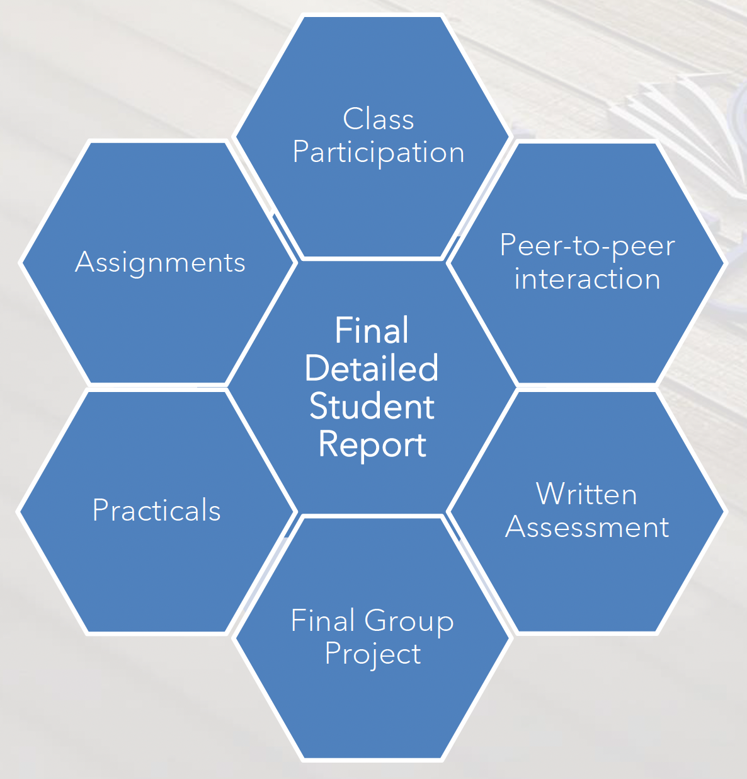
Assessment

